Slide 1
Abaqus Python
Abaqus Python Scripting
Learn with the concepts
Lec 10 – Create a Model
Notes:
Welcome you all once again to the Abaqus Python YouTube Channel.
This is Abaqus Python Script Learn …………. Lecture series.
In the last lecture, Lecture 8, we have seen how to create the ODB. If you have not watched previous video, please watch that video first. You will find the link in the I button.
In this lecture, Lecture 9, we will discuss how to write the data to ODB and visualize it as a contour.

Slide 2





Share
Share
Subscribe
Like
Subscribe
Like
Comment
Comment
Download files used in this lecture:
Python Script
Data file
ODB file
Explanation ppt
https://github.com/Abaqus-Python/Lec10_Create-A-Model
Notes:
Before starting today’s discussion, one announcement. I am sharing the all the content i.e. all the files I have used in these lecture series. These files I have saved in GitHub. So, for each video, whatever the files I have used, you will find the GitHub link in the description of that particular video. So you can download it. So, please go through these files and learn more. Also, You will find one website links files in the GitHub where I have saved the links of Abaqus Help Manual, PDF as well as Online.
And last thing if you like my content, please support this channel, So please like, share, subscribe and comment.
That being said let start the discussion.

Slide 3
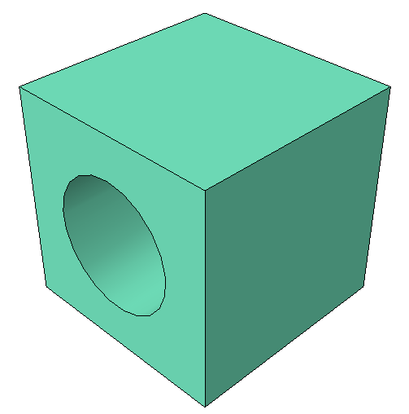
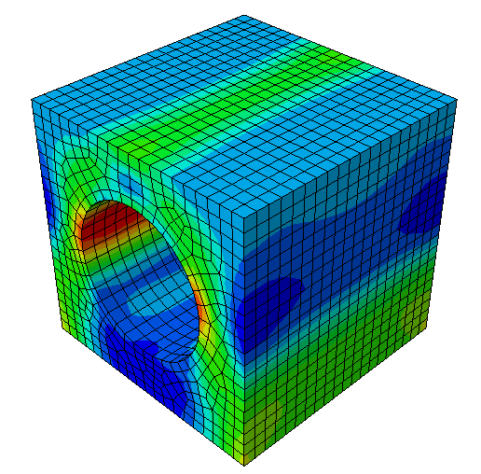




Create a Model:
Model
Results
$$p$$
6mm
20mm
20mm
Notes:
First, we will discuss what data you can use to create the contour.
So, the first case could be that you have data in some file or the data could be the output of your Analytical method calculation.
So that data you can visualize as contour.
In this case, you need to create the ODB. For that you can refer my Lecture number 8 on How to create ODB.
And then you can write the data ODB and can visualize it as contour.
Cool right, visualizing the data as a color contour.
Okay.

Slide 4
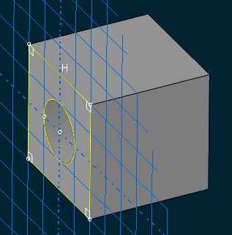





Create a Model:
$$σ$$
$$ε$$
Part
Material Properties
Assembly
Static
Dynamic
Visco
Coupled
Define Analysis
Loads and BC
Mesh
Notes:
Next case, let’s say you have ODB file.
The results in the ODB are not enough, so you want to post-process the existing contour results to get meaningful or understandable contour results.
For example, Let’s you have displacement in X direction i.e. U1 and displacement in Y-direction. And you want to sum it up and see as contour. This is just an simple example.
Okay. As you know that in the ODB you just have U1 and U2 i.e. displacement in X direction and displacement in Y-direction. So, we need to use this contour and post-process it.
So, here we are creating a new Field Outputs from existing field outputs.
And this is super easy. Abaqus Python is powerful enough to let us create this kinds of contours easily.
So, other examples could be – calculating the Fatigue Life or Fatigue Damage from Stress or Strain contours.
In that case, we need to post-process the stress and strain results to arrive at the Fatigue Life or Fatigue Damage.
Okay. That’s Enough theory. Now let’s write some code.

